Slide 1
Computer Organization 1
Logic Gates and Adders

Slide 2
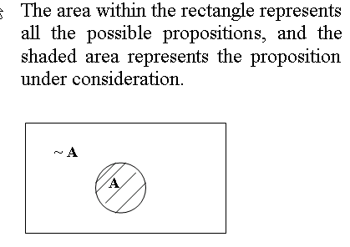
Propositions –Venn Diagrams

Slide 3
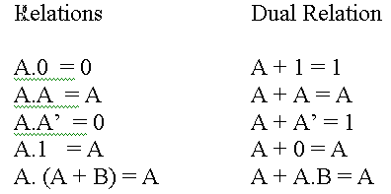
Duals and de Morgan’s Law
One help in dealing with expressions is the concept of duality.
Say a relation is true: To obtain the dual of a true relation, convert all 1s to 0s, all 0s to 1s, all ANDs to ORs, all ORs to ANDs. The dual will also be true.

Slide 4
De Morgan’s law
Another device to simplify logic expressions.
Change ANDs to ORs and ORs to ANDs
Negate all variables
Negate the resulting expression
Consider : ~(p + q) . ~r
Apply De M’ to ~(p + q) :
~(p + q) . ~r = ~p.~q . ~r
Apply De M’ to whole expression:
~p.~q . ~r = ~(p + q + r)

Slide 5
Other Rules which apply:
Commutative law: (Order of variables can be changed)
  a.b = b.a
  a + b = b + a
Associative Law (brackets can be moved)
  a.(b.c) = (a.b).c = a.b.c
  a + ( b+ c) = (a + b) + c = a + b + c
Distributive law (Similar to multiplying brackets in algebra)
  a.(b + c) = a.b + a.c
  (a + b). (a +c) = a + a.c + b.a + b.c = a + b.c

Slide 6
Examples - 1
Simplify: A + B(A + B) + A(~A + B)
A + B(A + B) + A(~A + B)
= A + BA + B + A.(~A +B)
= A + B + A. ~A + A.B
= A + B + 0 + AB
= A + B

Slide 7
Examples - 2
Simplify ~(~A + ~ (B.C) + ~C.B )
~(~A + ~ (B.C) + ~C.B )
= A.(B.C). ~(~C.B)
  (like applying De M’s law to ~(x+y+z) = ~x.~y.~z)
= A.B.C.(C + ~B)
= ABC + ABC.~B
= ABC + 0

Slide 8
Combinational Circuits
Values of the output depends only on the state of the inputs
No memory needed
maybe more than 2 inputs
Combinational Logic
OUTPUTS

Slide 9
Sequential Circuits
Value depends on the inputs but also on the past values of the circuit
Needs memory
  Traffic Lights, Elevator control
Sequential Logic
INPUTS
OUTPUTS
MEMORY

Slide 10
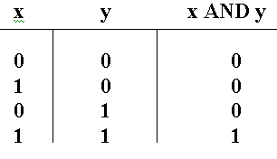
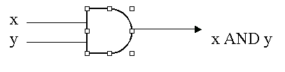
AND Gate

Slide 11

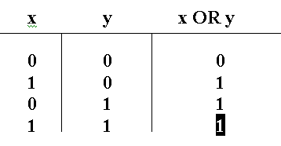

Slide 12


NOT Gate
Also known as an Inverter
Truth Table:

Slide 13
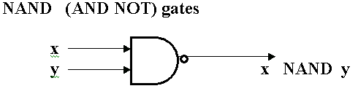
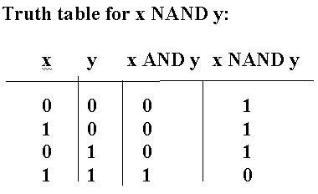

Slide 14

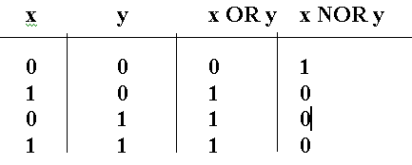
NOR Gates (NOT OR)
Truth Table

Slide 15
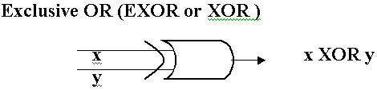
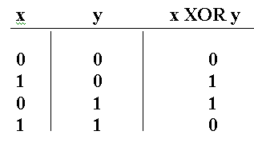
Truth Table for EXOR

Slide 16
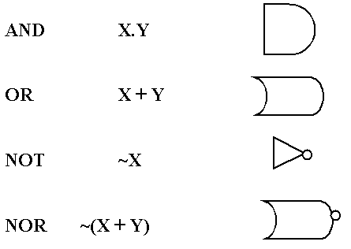
Basic Logic Gates
Operator Operation Symbol

Slide 17
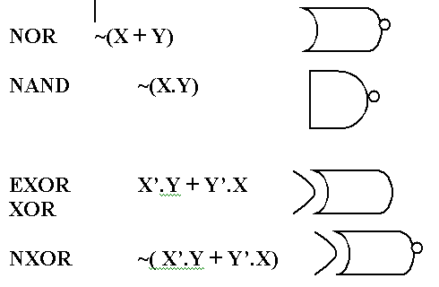
Basic Logic Gates
Operator Operation Symbol

Slide 18
The Half Adder - Addition of 2 bits
a b Sum ‘S’ Carry ‘C’
0 0 0 0
0 1 1 0
1 0 1 0
1 1 0 1
From the above we can see that
S = a EXOR b ie a.b’ + a’.b
And C = a.b
Gates can be combined to produce a device to give both the S and C outputs: The half-adder

Slide 19
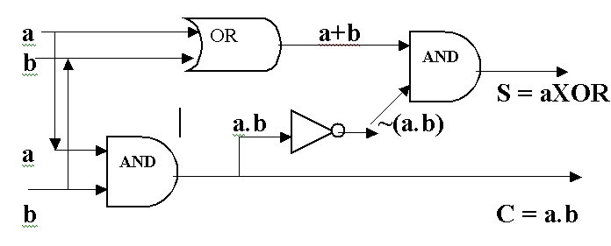
Combining Gates for Arithmetic - Addition of 2 bits a + b – The Half Adder
Gates can be combined to produce a device to give both the S (ab’ + a’b) and C (a.b) outputs:

Slide 20
The Full Adder
The full adder can deal with a carry from a previous 2 bit sum, and so has 3 inputs: a, b, and p, (the previous carry)
For example, add 4 bit integers 0011 and 0101:
Carries: 11
0011
+ 0101
------
1000
Prevs: 0110

Slide 21
The Full Adder S (sum) and C (Carry)
INPUTS OUTPUTS
p a b S C
0 0 0 0 0
0 0 1 1 0
0 1 0 1 0
0 1 1 0 1
1 0 0 1 0
1 0 1 0 1
1 1 0 0 1
1 1 1 1 1

Slide 22
Full Adder
We can see that for SUM S, Carry C:
S = p’.a’.b +p’.a.b’ + p.a’.b’ + p.a.b
C = p’ab + pa’b + pab’ + pab
Simplify the expression for S:
S = p’a’b +p’ab’ + pa’b’ + pab
= p’(a’b + ab’) + p.(a’b’ + ab)
p a b S C
0 0 0 0 0
0 0 1 1 0
0 1 0 1 0
0 1 1 0 1
1 0 0 1 0
1 0 1 0 1
1 1 0 0 1
1 1 1 1 1

Slide 23
Full Adder
Take (a’b’ + ab) and apply De Morgan’s law:
change all AND to OR; all OR to AND:
(a’ + b’).(a +b)
now negate all variables:
(a + b). (a’ + b’) = a.a’ + a.b’ + b.a’ + b.b’= ab’+ba’
And negate the resulting expression:
So, (a’b’ + ab) = ~ (ab’ + a’b)
That is, S = p’(a’b + ab’) + p. ~(a’b + ab’)
We remember from the half adder that
S ½ A = a EXOR b ie a’b + ab’
So, S (full Adder) = p’.( S ½ A) + p. ~(S ½ A)

Slide 24
The Full Adder
To simplify the expression for full adder C (Carry)
C = p’ab + pa’b + pab’ + pab
C = p’ab + pa’b + pab’ + pab
= ab(p + p’) + p(a’b + ab’)
= ab + p(a’b + ab’)
= ab + p( S ½ A)

Slide 25
The Full Adder
Remember that we have established that the outputs from a full adder (3 inputs a, b, p(revious) ) are S(um) and C(arry) given by:
S (full Adder) = p’.( S ½ A) + p. ~(S ½ A)
For simplicity: p’.y+p.y’ (where y is (S ½ A)
C = ab + p.( S ½ A)

Slide 26

The Full Adder
S (full Adder) = p’.( S ½ A) + p. ~(S ½ A)
C = a.b + p.( S ½ A)
Use this Symbol:

Slide 27
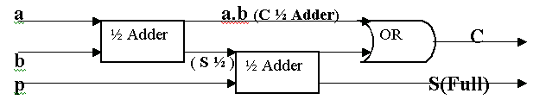
The Full Adder

Slide 28
Full Adder
S (full Adder) = p’.( S ½ A) + p. ~(S ½ A)

Slide 29
Circuit equivalence
It is much more economical to represent combinational circuits using one type of gate, rather than a selection.
Let us look at replacing the different types of gates with only NAND or only NOR gates.

Slide 30
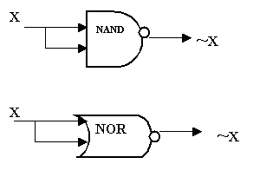
Circuit Equivalence - NOT
NOT

Slide 31

Circuit Equivalence
AND using NAND gates

Slide 32
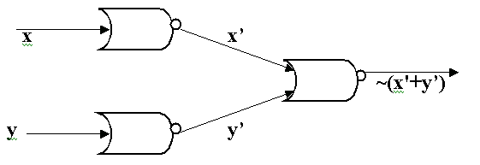
Circuit Equivalence
AND using NOR
Remember x.y = ~(x’ + y’) (by De M’)

Slide 33
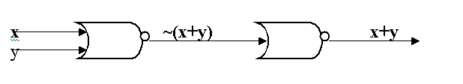
Circuit Equivalence
OR using NOR

